Slide 1
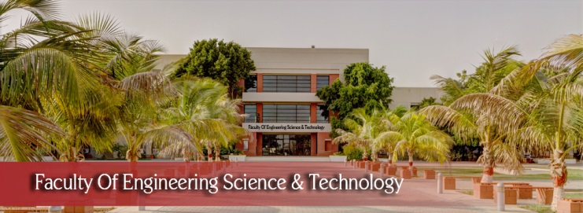

FYP
Project Name: A website for DOC, Hamdard University
Group members: Shahmeer Abid(2278-2021),
Syeda Noreen Zahra(2025-2021),
Hamza Sheikh(2595-2021)
Supervisor: Sir Afzal
Department of Computing, FEST
Hamdard University

Slide 2
Summary
Problem Statement
Objective
FYP Scope
Our methodology
Our Project Plan (Time lines)
Budget / Costing (if any)
FYP Deliverables
References
Item in red color are fundamental in any proposal

Slide 3
Problem Statement
There is no dedicated online platform for the Department of Computing. Manual processes for announcements, student queries, faculty interaction, and event updates lead to delays and confusion.
New students lack access to key information like department overview, assigned faculty, events, and program details. There is also no centralized space to explore societies, their activities, or faculty details.
By developing an integrated website with sub-webpages for CS, SE, and AI, dedicated faculty pages, society section, and a chatbot, the project aims to streamline communication, improve accessibility, and centralize departmental management.

Slide 4
Objective
To develop a dynamic and user friendly website for the Department Of Computing (DOC) Hamdard University.

Slide 5
FYP Scope
The scope of proposed project is to develop a dynamic and user friendly website for the department of computing. Following features will be included in website:
Home page
Sub Webpages for specific faculties
Detailed Departmental Information
Faculty pages of specific faculty
Events, News Announcement area
Societes page
Admin panel to manage announcement and other things
Chat bot

Slide 6
Our Methodology
Evolutionary prototype methodology is used for developing the Department of Computing website, by using this methodology, team will approach each functionality repeatedly, will make changes according to user feedback and improving overtime.

Slide 7
Literature Review
Features | University of Sindh, Jamshoro | IBA, Karachi | University of Lahore | KUST | Air University Pakistan | DOC FEST-HU
Home Page |  |  |  |  |  | 
Sub Web pages of CS, SE, AI |  |  |  |  |  | 
Announcement |  |  |  |  |  | 
Admin panel |  |  |  |  |  | 
Info of Department Faculty |  |  |  |  |  | 
Societies Page |  |  |  |  |  | 
Chat bot |  |  |  |  |  | 

Slide 8
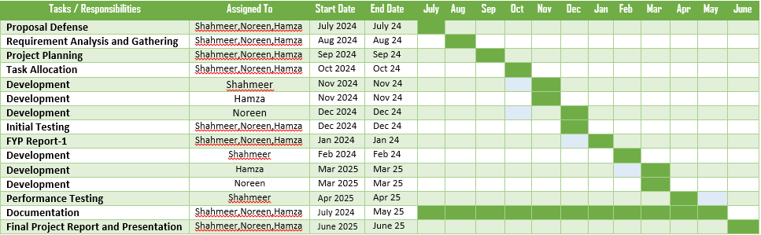
Our Project Plan

Slide 9
Budget / Costing
Components | Prices
2 laptops | 60,000 + 45000 = 1,05,000
Miscellaneous expenses | 8000
Printing of documents | 4000
Total | 1,17,000

Slide 10
FYP Deliverables
FYP-I Evaluation
FYP-II Evaluation
SRS Document
Requirement analysis and gathering
Project Plan and Task Allocation
Initial Prototype
Development Core functionalities (Home page, sub pages, Societies page, Login credentials)
Testing and Report
Documentation and Report - I
Advance feature Development (Admin panel, Announcement area, Faculty information and Chat bot)
Database Management
Backend Development
Integration
Testing
Final Refinement
Project Completion and Report - II

Slide 11
Experimental Evaluations & Results
Experimental evaluations were conducted to assess the performance and usability of the Department of Computing website. The system was tested on chrome to ensure responsiveness and compatibility. All dynamic features, including the admin panel, announcement system, faculty data, and chatbot, were evaluated for accuracy and stability. The SQLite database handled data operations efficiently, and the user interface was found to be intuitive. Overall, the results confirmed that the system met its functional requirements and provided a reliable and user-friendly experience for both admins and visitors.

Slide 12
Test Plan & Test Cases
A test plan was designed to validate the core functionalities of the Department of Computing website. Key test cases included checking announcement uploads, HOD message display, faculty and coordinator data rendering, sub-page navigation (CS, SE, AI), and chatbot responses. The admin login system was tested for both valid and invalid credentials. Event image uploads were also verified on the society page. Each test case ensured the proper functioning of features, correct data display, and secure access. All critical features were tested manually and passed successfully during functional testing.

Slide 13
Reference
Internet Web page: University Of Lahore. “Faculties and Departments”. Last seen: 30 June 2024.
URL: https://uol.edu.pk/faculties-dept/
Internet Web page: Kohat University of Science and Technology. “Institute of Computing”. Last visit: 30 June 2024.
URL: https://www.kust.edu.pk/kust/index.php/academics/faculties/faculty-of-physical-numerical- sciences/institute-of-computing
Internet Web page: Air University Islamabad. “Faculty of Computing and AI”. Last visit: 30 June 2024.
URL: https://www.au.edu.pk/Pages/Faculties/Computing_AI/fact_cs_dean_msg.aspx
Internet Web page: University of Sindh, Jamshoro. “Faculty of Engineering and Technology”. Last visit: 30 June 2024.
URL: https://usindh.edu.pk/
Internet Web page: IBA Karachi. “Undergraduate Programs”. Last visit: 30 June 2024.
URL: https://www.iba.edu.pk/undergraduate.php

